Slide 1

Kelsey Hammond
Dani Halloran
Haley Michael
Taylor Oster
Robert Reny
Risk assessment and waste migration south of red cloud mine

Slide 2
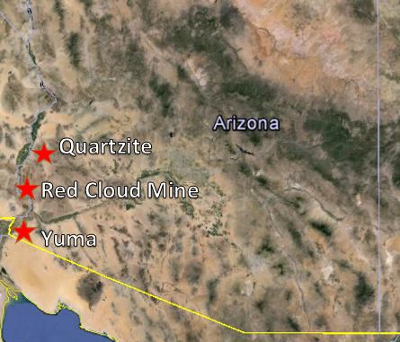
Project Scope
Preliminary Assessment and Site Inspection (PA/SI)
  Determine extent and toxicity of tailings in Black Rock Wash
  Mine located on private land
Bureau of Land Management (BLM) project
  Client: Eric Zielske, Professional Environmental Engineer
Contaminant of Concern (COCs) found in 2009 BLM Study
  Lead
80 Miles
Figure 1: Location of Red Cloud Mine (created in Google Earth by Kelsey Hammond)
Notes:
Haley

Slide 3
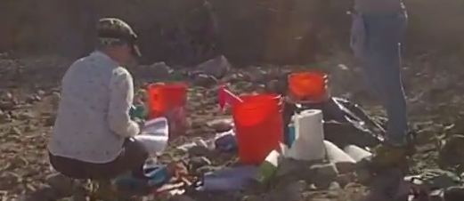
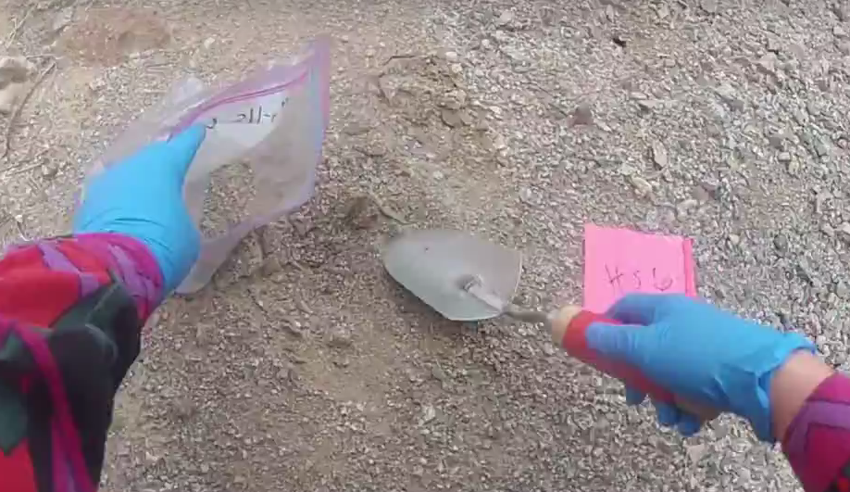
Field Sampling
Prior to Sampling
  Work Plan
    Sampling and Analysis Plan
    Health and Safety Plan
Field Sampling (1/30/16)
  Went according to Sampling Plan
  Grid: 80
  Hot Spots: 11
  Down Wash: 2
  Background: 3
Figure 2: Decontamination Set-up (Photo by Kelsey Hammond)
Figure 3: Kelsey Hammond Obtaining Sample using the techniques laid out in the Sampling Plan (Photo by Kelsey Hammond)

Slide 4
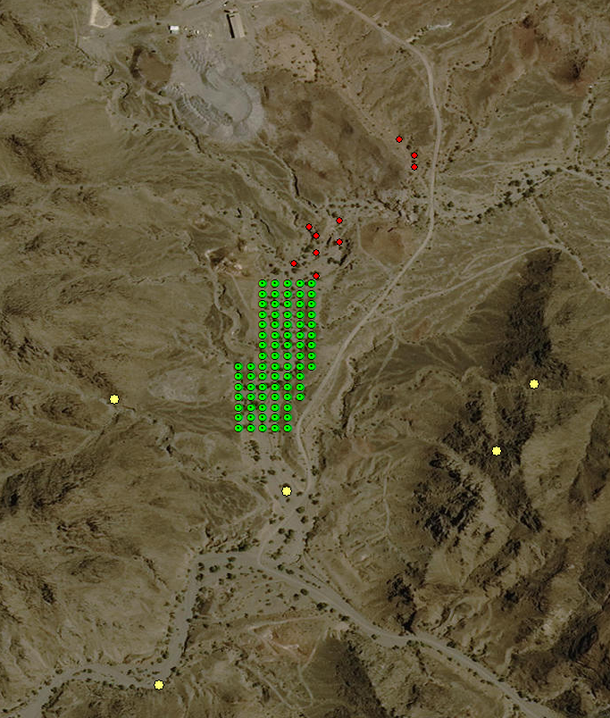
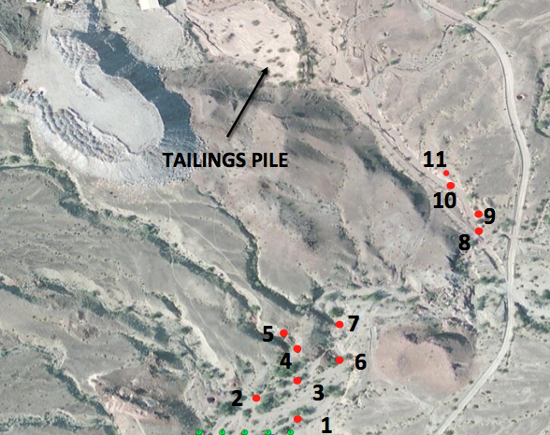

Sampling: Hot Spots
BK3
BK1
BK2
DW1
DW2
BK = Background
DW = Down Wash
200 ft
500 ft
Figure 4: Hot Spots (created by Dani Halloran in ArcMap)
Figure 5: Grid, Hot Spots, and Background Samples (created by Dani Halloran in ArcMap)
Notes:
Haley
Play video here

Slide 5
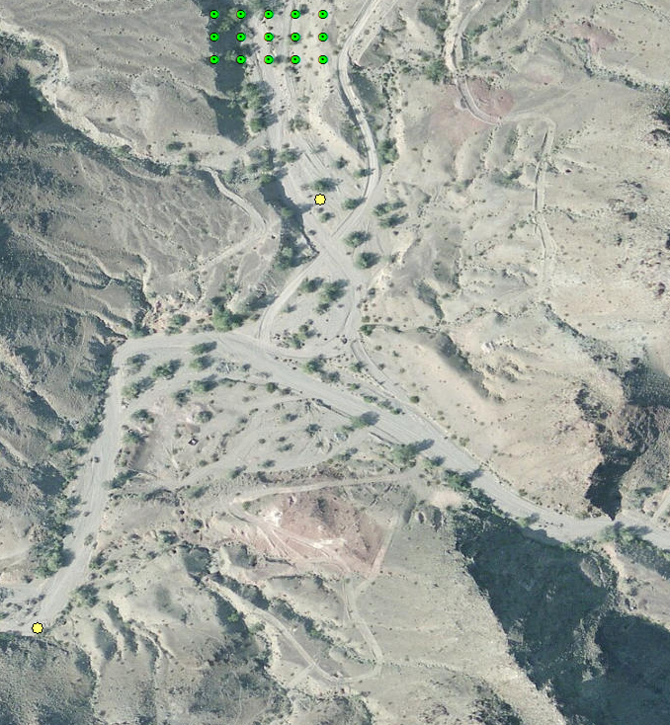
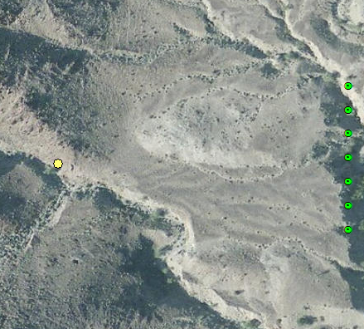
Sampling:
Background &
Down Wash
BK = Background
DW = Down Wash
DW1
BK1
BK3
BK2
DW1
BK3
DW2
200 ft
DW2
500 ft
200 ft
Figure 6: Background Sample (created by Dani Halloran in ArcMap)
Figure 7: Grid, Hot Spots, and Background Samples (created by Dani Halloran in ArcMap)
Figure 8: Down wash Samples (created by Dani Halloran in ArcMap)

Slide 6
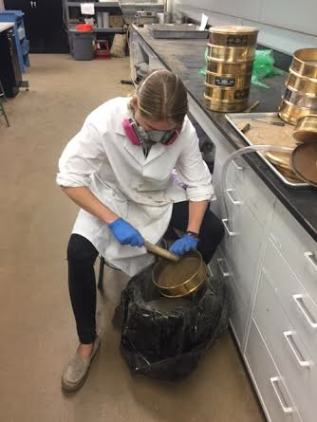
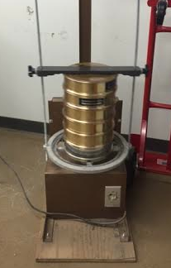
Analysis Preparation:
Drying and Sieving
EPA method 6200
All 96 bags were sieved
All waste disposed of as hazardous waste
Process:
  4-14-20-35-60 sieve stack
  Sieved for 10 minutes
  60 sieve material was transferred into a new bag
  Sieves were cleaned
Figure 9: Sieving stack (Photo taken by Dani Halloran)
Figure 10: Kelsey cleaning sieves (Photo taken by Dani Halloran)
Notes:
Kelsey
Talk about how tailings pile is next to rock pile of overburden which is what was originally thought to be the tailings pile.

Slide 7
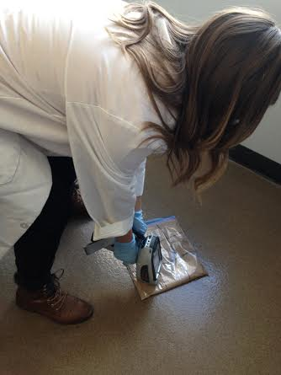
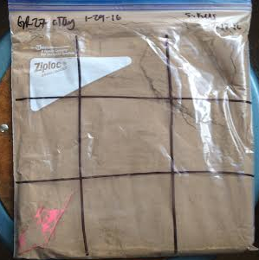
Analysis: XRF
  3x3 grid on bag
    Took out high and low concentrations
    Average of each bag
  X-Ray Fluorescence (XRF)
    Determine chemistry of a sample non- destructively
    Measure the fluorescence (secondary) x-rays emitted from a sample when excited by primary x-rays
Figure 11: 3x3 grid (Photo taken by Dani Halloran)
Figure 12: Taylor using the XRF (Photo taken by Dani Halloran)

Slide 8
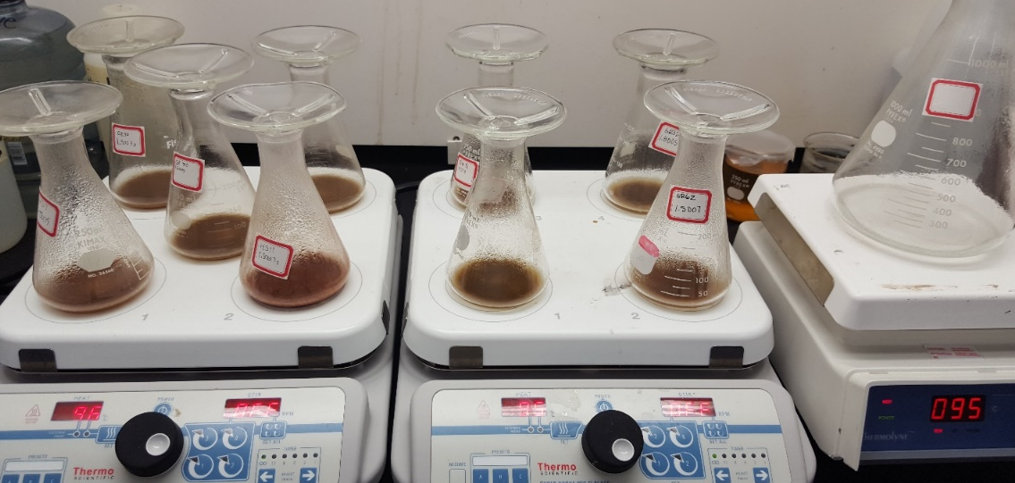
Analysis:
Atomic Absorption
  Flame Atomic Absorption (AA)
    Jeffrey Propster (Center for Ecosystem Science and Society)
    Double check XRF accuracy
    Calibration
Acid Digestion
  20 Samples
  Alternating additions of concentrated nitric acid + concentrated hydrogen peroxide
Figure 13. AA Lead Calibration Curve
Figure 14. Atomic Absorption Acid Digestion

Slide 9

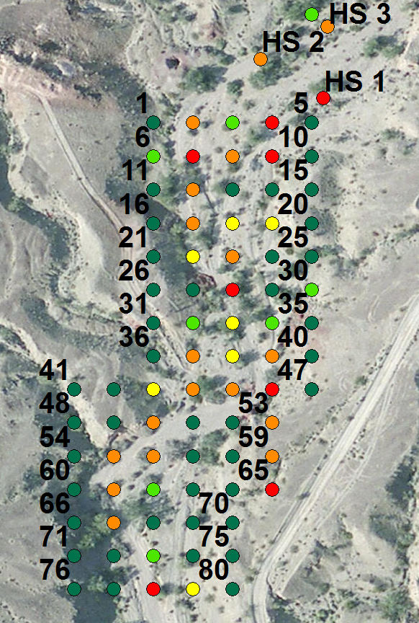
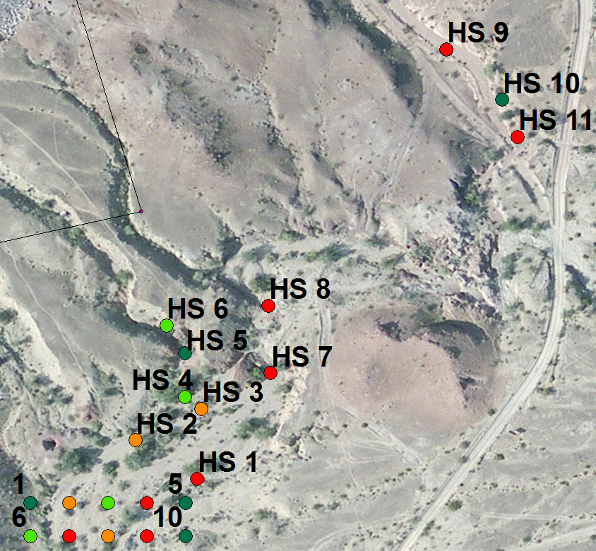
Sampling Results
15.17-400 ppm
400-800 ppm
800-1200 ppm
1200-2000 ppm
2000-16190.18 ppm
  AZ Regulation
    800ppm non-residential
  EPA Regulation
    1200ppm non-residential
  Not Shown:
    BK1: 88.27 ppm
    BK2: 102.97 ppm
    BK3: 29.15 ppm
    DW1: 1535.38 ppm
    DW2: 364.46 ppm
200 ft
200 ft
100 ft
Figure 15: Hot Spots (created by Dani Halloran in ArcMap)
Figure 16: Grid (created by Dani Halloran in ArcMap)

Slide 10
Risk Assessment
  Toxicity Assessment
  Exposure Assessment
    Magnitude
    Frequency
    Duration
    Route Exposure Assumptions
  Exposure Scenarios
    Adult & Child Recreational
      High use – 20 days/year
      Average use – 6 days/year
    Adult Full time worker
      330 days/year
    Adults part time worker
      150 days/year

Slide 11
Risk Assessment
Adult
Child
Adult Lead Methodology (ALM)
  Inputs –
    Soil concentrations at 50% and 95% percentiles and exposure frequency
  Outputs –
    Blood Lead Levels (PbB) (ug/dL)
    Probability that fetal PbB would exceed 10 (ug/dL)
    Reference Blood Lead Level: 10 ug/dL
Integrated Exposure Biokinetic and Uptake Model (IEUBKM)
  Inputs –
    Soil concentrations at 50% and 95% percentiles and exposure frequency
  Outputs –
    PbB (ug/dL), for children of age ranges 0-7 years
    Reference Blood Lead Level: 5 ug/dL

Slide 12
Human Health: Inputs
GRID
Geo. Mean (ppm) | 401.34
95th percentile (ppm) | 1680.2
GRID + DW
Geo. Mean (ppm) | 407.5
95th percentile (ppm) | 1680.7
HS
Geo. Mean (ppm) | 1679.6
95th percentile (ppm) | 11751.81
ALL
Geo. Mean (ppm) | 452.4
95th percentile (ppm) | 4358.41
Table 1. Mean and 95% of data
Figure 17. Lead Concentration Frequencies

Slide 13
Human Health: Results
Children < 5 ug/dL Adults < 10 ug/dL
IEUBK Child Lead Model
Adult Lead Methodology
High use (20 days)
95% (1680 ppm) | PbB (ug/dL)
.5-1 years old | 1.9
1-2 years old | 2.1
2-3 years old | 2.0
3-4 years old | 1.9
4-5 years old | 1.6
5-6 years old | 1.5
6-7 years old | 1.3
50% (407 ppm) | PbB (ug/dL)
.5-1 years old | 1.1
1-2 years old | 1.2
2-3 years old | 1.1
3-4 years old | 1
4-5 years old | 0.9
5-6 years old | 0.9
6-7 years old | 0.8
Average Use (7 days)
95% (1680 ppm) | PbB (ug/dL)
.5-1 years old | 1.3
1-2 years old | 1.3
2-3 years old | 1.3
3-4 years old | 1.2
4-5 years old | 1.0
5-6 years old | 0.9
6-7 years old | 0.9
50% (407 ppm) | PbB (ug/dL)
.5-1 years old | 1
1-2 years old | 1
2-3 years old | 0.9
3-4 years old | 0.9
4-5 years old | 0.8
5-6 years old | 0.8
6-7 years old | 0.7
Scenario | PbB (ug/dL) | Probability that fetal PbB > PbBt
Adult Worker
Full-time (330 days)
95% (1680 ppm) | 5.1 | 15.0%
50% (407 ppm) | 2.4 | 1.90%
Part-time (150)
95% (1680 ppm) | 3.2 | 4.50%
50% (407 ppm) | 1.9 | 0.90%
Adult Recreational
High use (20 days)
95% (1680 ppm) | 1.7 | 0.60%
50% (407 ppm) | 1.6 | 0.40%
Average Use (6 days)
95% (1680 ppm) | 1.6 | 0.40%
50% (407 ppm) | 1.5 | 0.40%
Table 2 & 3. IEUBK Lead Model for chosen scenarios
Table 4. Adult Lead Methodology for chosen scenarios

Slide 14
Ecological Health
Ingestion by Fauna
Absorption by Flora
Ingestion by fauna
Down Wash migration via surface water
Red Cloud Mine Tailings
Air migration
Deposition to soils
Deposition to soils
Table 5. Ecological Health broken down by present species
Figure 18. Exposure Pathways

Slide 15
Schedule
TASK | SCHEDULED COMPLETION | ACTUAL COMPLETION
1.0 WORK PLAN | 12/11/15 | 12/11/15
1.1 SAP | 12/11/15 | 12/11/15
1.2 HASP | 12/11/15 | 12/11/15
2.0 SAMPLING | 1/30/16 | 1/30/16
3.0 ANALYSIS | 3/9/16 | 3/9/16
3.1 Sample Prep for XRF | 2/17/0216 | 2/17/0216
3.2 XRF | 3/2/16 | 3/2/16
3.3 Sample Prep for AA | 3/7/16 | 3/7/16
3.3.1 Digestion | 3/4/16 | 3/10/16
3.3.2 Chemistry Lab | 3/7/16 | 3/22/16
TASK | SCHEDULED COMPLETION | ACTUAL COMPLETION
4.0 RISK ASSESSMENT | 3/30/16 | 3/30/16
4.1 Human Health | 3/30/16 | 3/30/16
4.2 Ecological Health | 3/30/16 | 3/30/16
5.0 PA/SI | 5/6/16 | 5/6/16
5.1 50% PA/SI | 3/11/16 | 3/11/16
5.2 Final PA/SI | 5/6/16 | 5/6/16
6.0 PROJECT MANAGEMENT | 5/9/16 | 5/9/16
6.1 Presentation | 4/29/16 | 4/29/16
6.2 Website | 5/6/16 | 5/6/16
Table 6: Schedule Breakdown (Created by Kelsey Hammond)
Notes:
Kelsey

Slide 16
Economic Analysis
Service | Estimated | Actual | Estimated Costs | Actual Costs
Personnel | 750 hours | 687.5 hours | $51,579 | $54,677
Subcontract | $7.5/sample | $7.5/sample | $150 | $150
Travel |  |  | $1764 | $1418
- Per Mile | $.40/mi | $.40/mi | $264 | $264
- Per Diem | $80/person | $105/person | $400 | $525
- Hotel | $300/night | $162/night | $600 | $486
Total |  |  | $53,493 | $56,140
Table 7: Economic Analysis

Slide 17
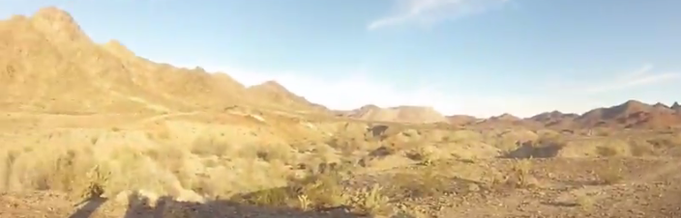
Impacts
Site specific exposure
Recommendations
Environmental Exposure
  Moderate Risk
Exposure to humans
  Moderate Risk
Possible remediation of tailings pile
Signage
Larger scale sampling
  Larger grid for un-biased results
  More in depth sampling based on wind migration
Figure 19. Red Cloud Mine and Black Rock Wash

Slide 18
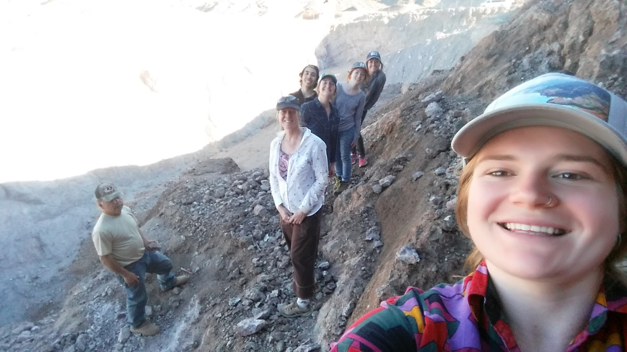
Questions?
Figure 20: Red Cloud Mine team and mine operator (photo taken by Kelsey Hammond)

Slide 19
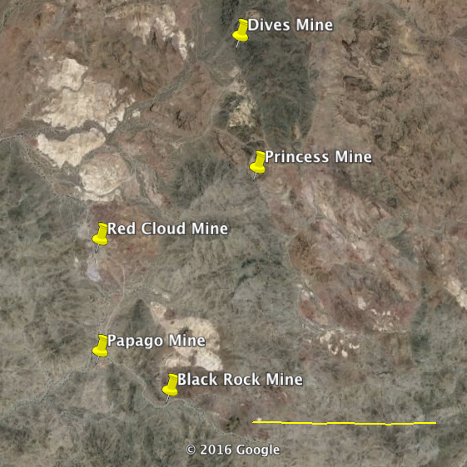
Mines Near
Red Cloud Mine
Red Cloud Mine
  33.1003158
  -114.5996761
Princess Mine
  33.1061489
  114.5846755
Papago Mine
  33.0914271
  -114.599676
Eureka Mine
  33.039206
  -114.5643966
Dives Mine
  33.1164265
  -114.5863423
Black Rock Mine
  33.0883715
  -114.5930091
1 Mile
Figure 21: Red Cloud Mine and Surrounding Mines

Slide 20
Results: Hot Spot Levels
Children < 5 ug/dL Adults < 10 ug/dL
IEUBK Child Lead Model
Adult Lead Methodology
High use (20 days)
95% | PbB (ug/dL)
.5-1 year | 7.4
1-2 year | 8.6
2-3 year | 8.1
3-4 year | 7.7
4-5 year | 6.4
5-6 year | 5.2
6-7 year | 4.5
50% | PbB (ug/dL)
.5-1 year | 1.9
1-2 year | 2.1
2-3 year | 2
3-4 year | 1.9
4-5 year | 1.6
5-6 year | 1.4
6-7 year | 1.3
Scenario | PbB (ug/dL) | Probability that fetal PbB > PbBt
Adult Worker
Full-time (330 days)
95% (2874 ppm) | 27 | 88.40%
50% (399 ppm) | 2.5 | 2.20%
Part-time (150)
95% (2874 ppm) | 13.1 | 58.70%
50% (399 ppm) | 3.2 | 4.50%
Adult Recreational
High use (20 days)
95% (2874 ppm) | 3 | 4.10%
50% (399 ppm) | 1.7 | 0.6%
Average Use (6 days)
95% (2874 ppm) | 2 | 1.0%
50% (399 ppm) | 1.6 | .40%
Table 8: Children Model with Hot Spot Data
Table 9: Adult Model with Hot Spot Data

Slide 21
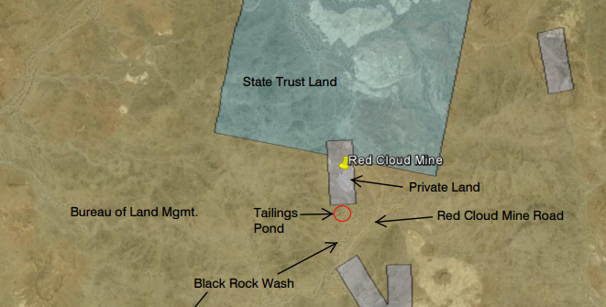
Original BLM Map
Figure 22: Red Cloud Mine, BLM Land, and State Trust Land

Slide 22
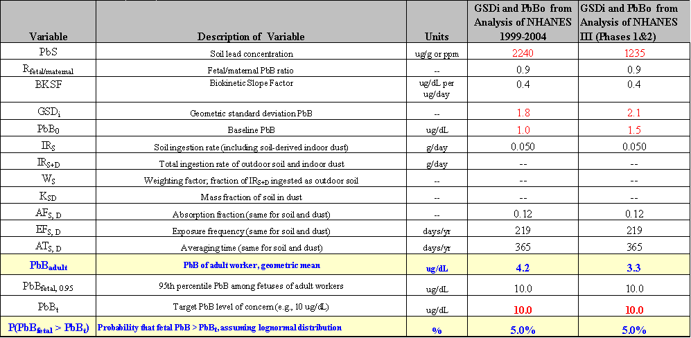
Table 10

Slide 23
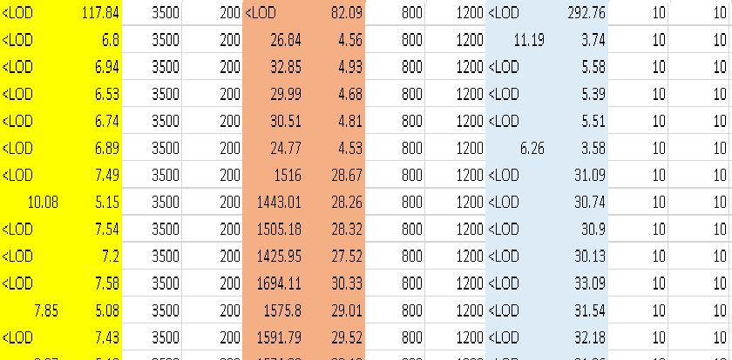
Other Contaminates
Table 11

